Slide 1
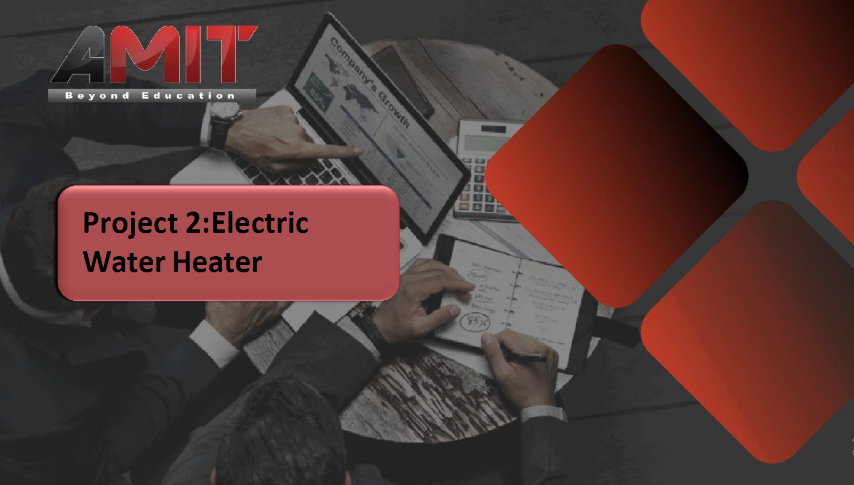

Slide 2
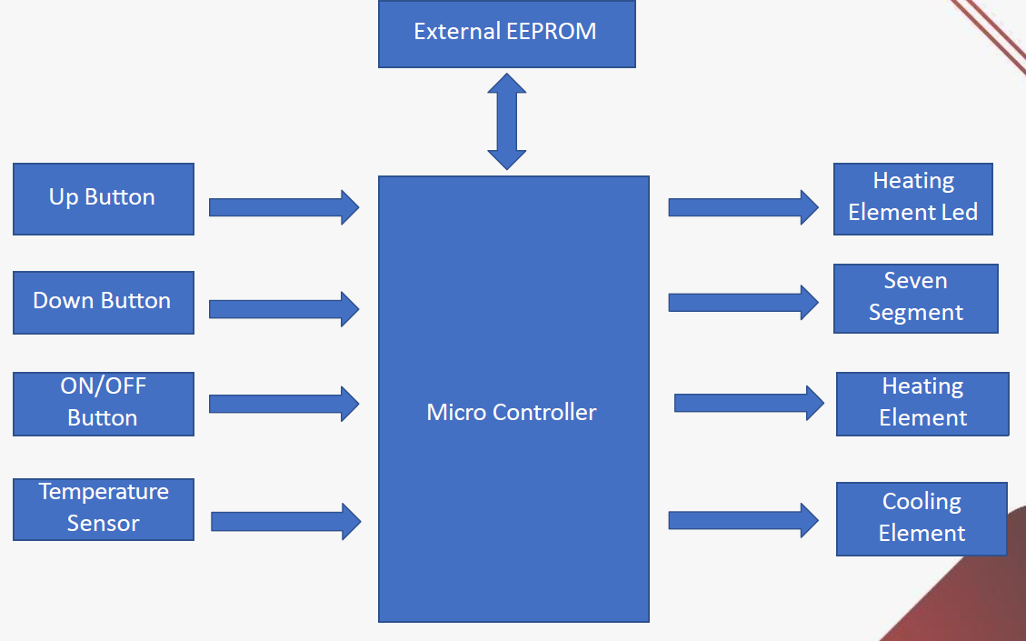
Specifications

Slide 3
Specifications
All Used Peripherals:
Timer0 ,Timer2
Interrupt1
I2C
ADC
EEPROM
All Ports Used:
Port A1, from A4 to A7
Port B6, B7
Port C1 to C5, C7
Port D0, D1, D3

Slide 4
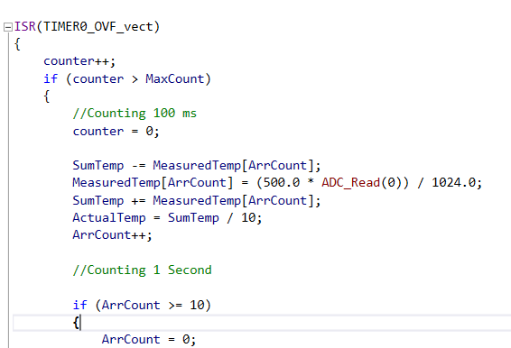
Specifications – Temperature Sensing
Variables Used:
SumTemp
Array MeasuredTemp
ActualTemp
ArrCount
Peripherals Used:
Timer0
ADC
Ports Used:
Port A1

Slide 5
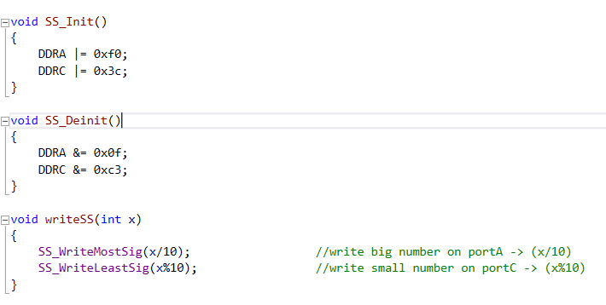
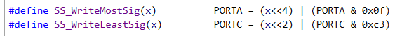
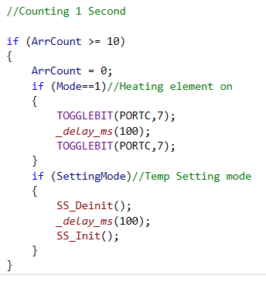
Specifications – Seven Segments and Heating LED
Peripherals Used:
Timer0
Ports Used:
Port A4 to A7
Port C2 to C5
Port C7

Slide 6
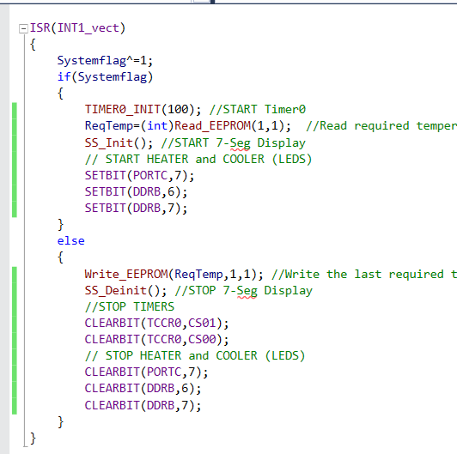
Specifications – ON/OFF button
Peripherals Used:
Timer0
EEPROM
Timer2
Ports Used:
Port C7
Port B6, B7

Slide 7
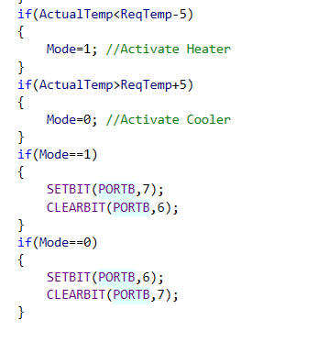
Switching between Heater and Cooler
Mode 0 means cooler is activated
Mode 1 means heater is activated
They don’t work simultaneously

Slide 8
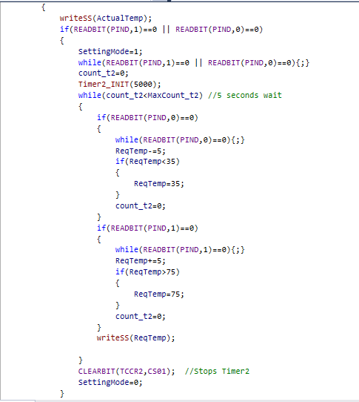
UP an DOWN buttons
Peripherals Used:
Timer2
EEPROM
Ports Used:
Pin D0 ,D1

